Slide 1
ITDO6014 aI AND DS-1
Module 1: Introduction to AI

Slide 2
Course Objectives
To introduce the students’ with different issues involved in trying to define and simulate intelligence.
To familiarize the students’ with specific, well known Artificial Intelligence methods, algorithms and knowledge representation schemes.
To introduce students’ different techniques which will help them build simple intelligent systems based on AI/IA concepts.
To introduce students to data science and problem solving with data science and statistics.
To enable students to choose appropriately from a wider range of exploratory and inferential methods for analyzing data, and interpret the results contextually.
To enable students to apply types of machine learning methods for real world problems.

Slide 3
Course Outcomes
Develop a basic understanding of the building blocks of AI as presented in terms of intelligent agents.
2 Apply an appropriate problem-solving method and knowledge-representation scheme.
3 Develop an ability to analyze and formalize the problem (as a state space, graph, etc.). They will be able to evaluate and select the appropriate search method.
4 Apply problem solving concepts with data science and will be able to tackle them from a statistical perspective.
Choose and apply appropriately from a wider range of exploratory and inferential methods for analyzing data and will be able to evaluate and interpret the results contextually.
6 Understand and apply types of machine learning methods for real world problems.

Slide 4
Grading
Internal Assessment | 20 Marks
Theory | 80 Marks
Total | 100 Marks
Text Book:
1. Stuart Russell and Peter Norvig, Artificial Intelligence: A Modern Approach, 2nd Edition, Pearson Education.
2. Elaine Rich, Kevin Knight, Shivshankar B Nair, Artificial Intelligence, McGraw Hill, 3rd Edition

Slide 5
Grading
Online References:
Website/Reference link
1. https://nptel.ac.in/noc/courses/noc19/SEM2/noc19-cs83/
2. https://nptel.ac.in/courses/106/105/106105077/
3. https://www.coursera.org/specializations/jhu-data-science
4. https://www.coursera.org/learn/machine-learning
5. https://www.udemy.com/course/statistics-for-data-science-and-business-analysis/

Slide 6
Introduction to AI
According to the father of Artificial Intelligence, John McCarthy, it is “The science and engineering of making intelligent machines, especially intelligent computer programs”.
Artificial Intelligence is a way of making a computer, a computer-controlled robot, or a software think intelligently, in the similar manner the intelligent humans think.
AI is accomplished by studying how human brain thinks, and how humans learn, decide, and work while trying to solve a problem, and then using the outcomes of this study as a basis of developing intelligent software and systems.

Slide 7
Introduction to AI
Definitions of artificial intelligence, organized into four categories:
1. System that reasons (thinks) like human
2. System that reasons (thinks) rationally
3. System that acts like human
4. System that acts rationally

Slide 8
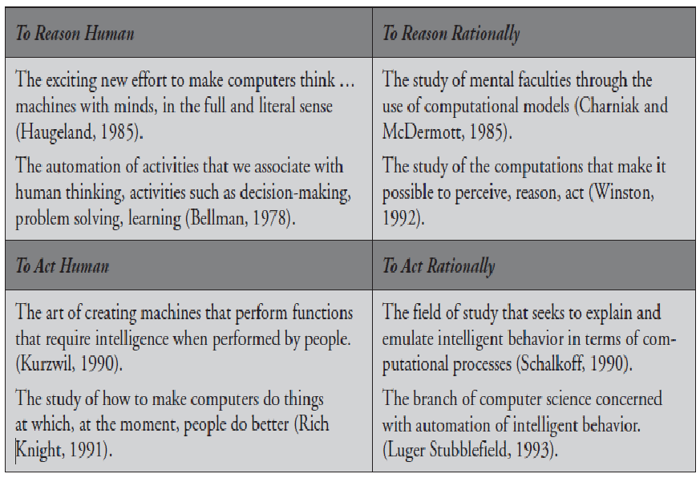
Introduction to AI

Slide 9
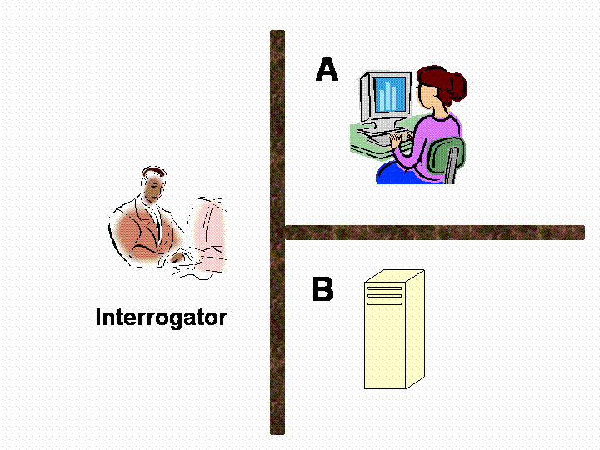
Introduction to AI
The Turing Test approach

Slide 10
Introduction to AI
Consider the following setting. There are two rooms, A and B. One of the rooms contains a computer. The other contains a human. The interrogator is outside and does not know which one is a computer. He can ask questions through a teletype and receives answers from both A and B. The interrogator needs to identify whether A or B are humans. To pass the Turing test, the machine has to fool the interrogator into believing that it is human.

Slide 11
Introduction to AI
programming a computer to pass the test provides plenty to work on. The computer would need to possess the following capabilities:
Natural language processing to enable it to communicate successfully in English
Knowledge representation to store what it knows or liears;
Automated reasoning to use the stored inforrnation to answer questions and to draw new conclusions;
Machine learning to adapt to new circumstances and to detect and extrapolate patterns.

Slide 12
Introduction to AI
Computer vision to perceive objects, and
Robotics to manipulate objects and move about.
These six disciplines compose most of AI

Slide 13
History of AI
1956 - John McCarthy coined the term ‘artificial intelligence’ and had the first AI conference.
1969 - Shakey was the first general-purpose mobile robot built. It is now able to do things with a purpose vs. just a list of instructions.
1997 - Supercomputer ‘Deep Blue’ was designed, and it defeated the world champion chess player in a match. It was a massive milestone by IBM to create this large computer.
2002 - The first commercially successful robotic vacuum cleaner was created.
2005 - 2019 - Today, we have speech recognition, robotic process automation (RPA), a dancing robot, smart homes, and other innovations make their debut.
2020 - Baidu releases the LinearFold AI algorithm to medical and scientific and medical teams developing a vaccine during the early stages of the SARS-CoV-2 (COVID-19) pandemic. The algorithm can predict the RNA sequence of the virus in only 27 seconds, which is 120 times faster than other methods.

Slide 14
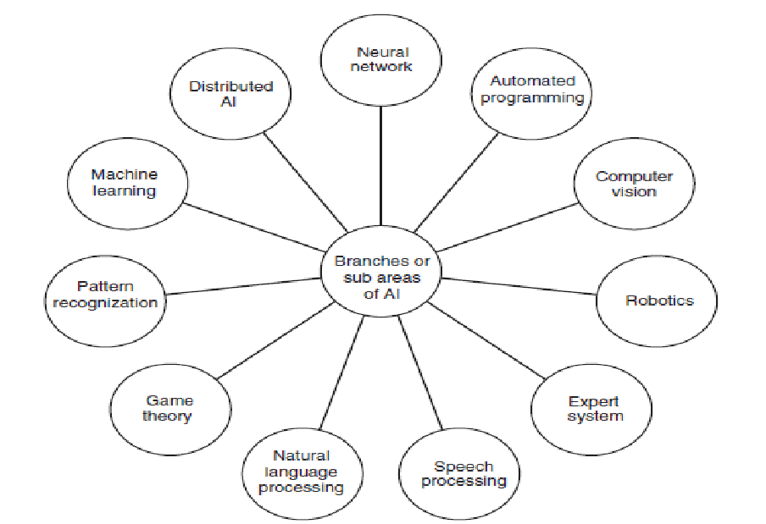
Branches of AI

Slide 15
AI Programming
A number of programming languages exist that are used to build AI
systems. General programming languages, such as C++, R, Java,
Python, and LISP (List Processing) are frequently used, because these
are the languages with which most computer scientists have got
experience.
Here are some languages that are most typically used for creating the
AI projects:
PROLOG, LISP, R, Python, Java, C++

Slide 16
AI Agent
An agent is anything that can be viewed as perceiving its environment through sensors and
SENSOR acting upon that environment through actuators.
ACTUATOR A human agent has eyes, ears, and other organs for sensors and hands, legs, mouth, and other body parts for actuators.
A robotic agent might have cameras and infrared range finders for sensors and various motors for actuators.
A software agent receives keystrokes, file contents, and network packets as sensory inputs and acts on the environment by displaying on the screen, writing files, and sending network packets

Slide 17
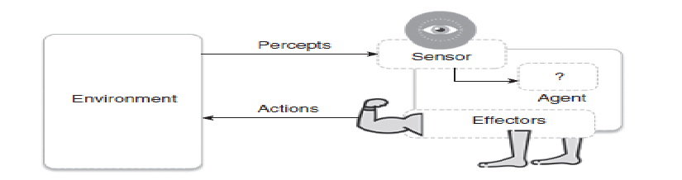
AI Agent

Slide 18
AI Agent
Agent terminology
Performance measure of agent: It is the criteria determining the success of an agent.
Behaviour/action of agent: It is the action performed by an agent after any specified sequence of the percepts.
Percept: It is defined as an agent’s perceptual inputs at a specified instance.
Percept sequence: It is defined as the history of everything that an agent has perceived till date.
Agent function: It is defined as a map from the precept sequence to an action.
Agent function, a = F(p)
where p is the current percept, a is the action carried out, and F is the agent function.

Slide 19
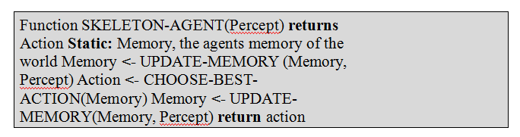
AI Agent
Agent program
On each invocation, the memory of the agent is updated to mirror the new percept, the best action selected and the fact that the action was taken is also stored inside the memory. The memory persists from one invocation to the next.

Slide 20
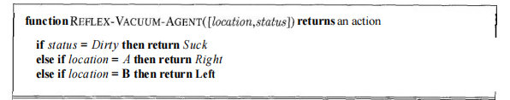
AI Agent

Slide 21
Properties of task environments
Fully observable vs. partially observable.
If an agent's sensors give it access to the complete state of the environment at each point in time, then we say that the task environment is fully observable. A task environment is effectively fully observable if the sensors detect all aspects that are relevant to the choice of action; relevance, in turn, depends on the performance measure.
Fully observable environments are convenient because the agent need not maintain any internal state to keep track of the world.
An environment might be partially observable because of noisy and inaccurate sensors or because parts of the state are simply missing from the sensor data-for example, a vacuum agent with only a local dirt sensor cannot tell whether there is dirt in other squares, and an automated taxi cannot see what other drivers are thinking.

Slide 22
Properties of task environments
Fully observable vs. partially observable.
Fully Observable Environment:
Imagine a grid world where the robot can see the entire grid at any given time.
The robot knows the exact positions of obstacles, goals, and any other relevant information in the entire grid.
Each grid cell is visible to the robot, and it has complete information about the state of the environment.
Example:
The robot is in a 5x5 grid world, and it knows the exact positions of walls, goals, and other objects in every cell.

Slide 23
Properties of task environments
Fully observable vs. partially observable.
Partially Observable Environment:
Now, let's consider a partially observable environment where the robot has limited visibility or sensor range.
The robot can only perceive a limited portion of the grid at any given time, making it unaware of the entire state of the environment.
The robot may need to remember its past observations or use sensors to gather information about the surroundings.
Example:
The robot is in the same 5x5 grid world, but it has a limited sensor range of 2 cells. It can only see the contents of the cells within this range.
As the robot moves, it updates its knowledge based on the newly observed cells, but it doesn't have complete information about the entire grid.

Slide 24
Properties of task environments
Single agent vs. multiagent.
The distinction between single-agent and multiagent environments may seem simple enough. For example, an agent solving a crossword puzzle by itself is clearly in a single-agent environment, whereas an agent playing chess is in a two-agent environment.
Chess is a competitive multiagent environment. In the taxi-driving environment, on the other hand, avoiding collisions maximizes the performance measure of all agents, so it is a partially cooperative multiagent environment.

Slide 25
Properties of task environments
Single agent vs. multiagent.
Single Agent Environment:
In a single-agent environment, there is only one entity or agent responsible for performing the tasks within the environment.
Example:
A robot is assigned to clean a single room. The robot is the only entity responsible for navigating through the room, identifying dirty areas, and cleaning them. There are no other agents involved in the task.

Slide 26
Properties of task environments
Single agent vs. multiagent.
Multiagent Environment:
In a multiagent environment, there are multiple agents, each with its own goals, and they may interact with or influence each other.
Example:
Consider a scenario where two robots are assigned to clean different rooms in a house. Each robot is a separate agent with the goal of cleaning its designated room. The robots may need to coordinate their actions to avoid collisions or share information about their progress. In this case, the environment involves multiple agents working simultaneously.

Slide 27
Properties of task environments
Static vs, dynamic.
If the environment can change while an agent is deliberating, then we say the environment is dynamic for that agent; otherwise, it is static. Dynamic environments are continuously asking the agent what it wants to do; if it hasn't decided yet, that counts as deciding to do nothing. Taxi driving is clearly dynamic: the other cars and the taxi itself keep moving while the driving algorithm dithers about what to do next.
Static environments are easy to deal with because the agent need not keep looking at the world while it is deciding on an action, nor need it worry about the passage of time. Crossword puzzles are static.
If the environment itself does not change with the passage of time but the agent's performance score does, then we say the environment is semidynamic. Chess, when played with a clock, is semidynamic.

Slide 28
Properties of task environments
Static vs, dynamic.
Static Environment:
In a static environment, the elements and features of the environment do not change over time.
Example:
A robot navigating through a museum where the layout, positions of exhibits, and obstacles remain constant. The robot can plan its path without worrying about changes in the environment during its navigation. The environment remains fixed, and there are no dynamic elements.

Slide 29
Properties of task environments
Static vs, dynamic.
Dynamic Environment:
In a dynamic environment, the elements and features of the environment can change over time.
Example:
Now, consider the same robot navigating through a busy city street. In this dynamic environment, the positions of pedestrians, vehicles, and other obstacles can change rapidly. The robot needs to adapt its navigation in real-time, taking into account the dynamic nature of the surroundings. The environment is not fixed, and various elements can move or change positions.

Slide 30
Properties of task environments
Deterministic vs. stochastic.
If the next state of the environment is completely determined by the current state and the action executed by the agent, then we say the environment is deterministic; otherwise, it is stochastic.
Taxi driving is clearly stochastic in this sense, because one can never predict the behavior of traffic exactly; moreover, one's tires blow out and one's engine seizes up without warning. The vacuum world as we described it is deterministic but variations can include stochastic elements such as randomly appearing dirt and an unreliable suction mechanism

Slide 31
Properties of task environments
Deterministic Environment:
In a deterministic environment, the outcome of an action is entirely predictable, given the current state of the environment and the action taken.
Example:
Imagine a board game where a player moves a token based on the roll of a fair six-sided die. In a deterministic environment, each roll of the die produces a predictable and fixed outcome. If the player rolls a 3, the token will move three spaces, and this result is consistent every time they roll a 3.

Slide 32
Properties of task environments
Stochastic Environment:
In a stochastic environment, the outcome of an action has some level of randomness or uncertainty, even if the current state and action are the same.
Example:
Now, consider a modified version of the board game where the player moves the token based on the roll of a biased die. The biased die has a chance of producing different outcomes, and the result may vary even if the player takes the same action multiple times. For example, rolling a 3 might result in the token moving three spaces most of the time, but occasionally it could move four or two spaces due to the biased nature of the die.

Slide 33
Properties of task environments
Discrete vs. continuous.
The discrete/continuous distinction can be applied to the state of the environment, to the way time is handled, and to the percepts and actions of the agent.
For example, a discrete-state environment such as a chess game has a finite number of distinct states. Chess also has a discrete set of percepts and actions.
Taxi driving is a continuous state and continuous-time problem: the speed and location of the taxi and of the other vehicles sweep through a range of continuous values and do so smoothly over time.
Taxi-driving actions are also continuous (steering angles, etc.). .

Slide 34
Properties of task environments
Discrete vs. continuous.
Discrete Environment:
In a discrete environment, the set of possible states and actions is finite, countable, or distinct. There is a clear separation between different states and actions.
Example:
Think of a robot navigating through a grid world. The robot can move from one grid cell to another, and each cell represents a distinct, discrete state. The robot's movement is limited to discrete actions, such as moving up, down, left, or right. The state and action spaces are well-defined and discrete.

Slide 35
Properties of task environments
Discrete vs. continuous.
Continuous Environment:
In a continuous environment, the set of possible states and actions is uncountable and can take on a continuous range of values. There is no clear separation between different states or actions.
Example:
Now, consider a robotic arm in a factory. The position of the robotic arm can take on a continuous range of values, and its movement is not constrained to discrete steps. The state space, representing the position of the arm, and the action space, representing the movement, are continuous. The arm can move smoothly between any two positions.

Slide 36
Properties of task environments
Episodic vs. sequential
In an episodic task environment, the agent's experience is divided into atomic episodes. Each episode consists of the agent perceiving and then performing a single action. Crucially, the next episode does not depend on the actions taken in previous episodes. In episodic environments, the choice of action in each episode depends only on the episode itself. Many classification tasks are episodic. For example, an agent that has to spot defective parts on an assembly line bases each decision on the current part, regardless of previous decisions; moreover, the current decision doesn't affect whether the next part is defective.
In sequential environments, on the other hand, the current decision could affect all future decisions. Chess and taxi driving are sequential: in both cases, short-term actions can have long-term consequences. Episodic environments are much simpler than sequential environments because the agent does not need to think ahead.

Slide 37
Properties of task environments
Episodic vs. sequential
Episodic Environment:
In an episodic environment, the agent's experience is divided into distinct episodes, and each episode is a self-contained task with a clear beginning and end. The agent's actions within one episode do not affect subsequent episodes.
Example:
Think of a game of chess. Each game is an episode with a clear start (initial board setup) and end (checkmate or stalemate). The outcome of one game doesn't influence the next game. The agent (player) starts fresh with a new board at the beginning of each game.

Slide 38
Properties of task environments
Episodic vs. sequential
Sequential Environment:
In a sequential environment, the agent's actions have a lasting impact on future states, and the current state depends on the agent's history of actions and observations.
Example:
Consider a video game where a character explores a virtual world. The character's actions, such as collecting items or defeating enemies, affect its future state and capabilities. The environment is sequential because the consequences of the character's actions persist over time, and the current state depends on the sequence of actions taken.

Slide 39
Properties of task environments
Scenario: Robot Vacuum in a House
Fully Observable vs. Partially Observable:
Fully Observable:
The robot vacuum has sensors covering the entire house, providing complete information about the location of furniture, walls, and dirty areas in the entire environment.
Partially Observable:
The robot vacuum has a limited sensor range, so it can only perceive and gather information about a small portion of the room at any given time. As it moves, it updates its knowledge based on new observations, but it doesn't have complete information about the entire house.

Slide 40
Properties of task environments
Scenario: Robot Vacuum in a House
Single Agent vs. Multiagent:
Single Agent:
There is only one robot vacuum in the house responsible for cleaning all the rooms.
Multiagent:
There are multiple robot vacuums, each assigned to clean a specific room. The robots may need to coordinate their movements to efficiently cover the entire house without collisions.

Slide 41
Properties of task environments
Scenario: Robot Vacuum in a House
Static vs. Dynamic:
Static:
The layout of the house remains constant, and there are no changes in the positions of furniture or obstacles during the cleaning process.
Dynamic:
Family members or pets are moving around the house, introducing dynamic elements that the robot must navigate around. The positions of these dynamic elements change over time.

Slide 42
Properties of task environments
Scenario: Robot Vacuum in a House
Deterministic vs. Stochastic:
Deterministic:
The robot's cleaning actions have predictable outcomes. If it detects a dirty area, it will always follow the same algorithm to clean it.
Stochastic:
The robot encounters different levels of dirtiness in the house, and its cleaning efficiency may vary due to the stochastic nature of dirt distribution. The outcomes of cleaning actions may have some randomness.

Slide 43
Properties of task environments
Scenario: Robot Vacuum in a House
Discrete vs. Continuous:
Discrete:
The robot moves from one grid cell to another within each room. Its cleaning actions are limited to discrete movements and operations.
Continuous:
The robot's sensors and movements operate in a continuous space, allowing it to smoothly navigate around obstacles without being constrained to discrete steps.

Slide 44
Properties of task environments
Scenario: Robot Vacuum in a House
Episodic vs. Sequential:
Episodic:
Each room-cleaning task can be considered as an episode with a clear beginning (entering the room) and end (finishing cleaning). The outcome of cleaning one room doesn't affect the cleaning of other rooms.
Sequential:
The robot's actions, such as deciding where to move next based on its cleaning progress, are sequential. The consequences of its cleaning actions persist, and the state of the environment depends on its history of movements and observations.

Slide 45
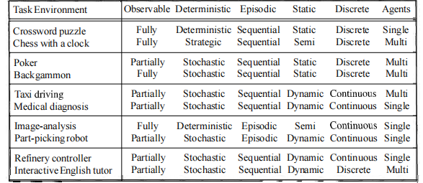
Properties of task environments

Slide 46
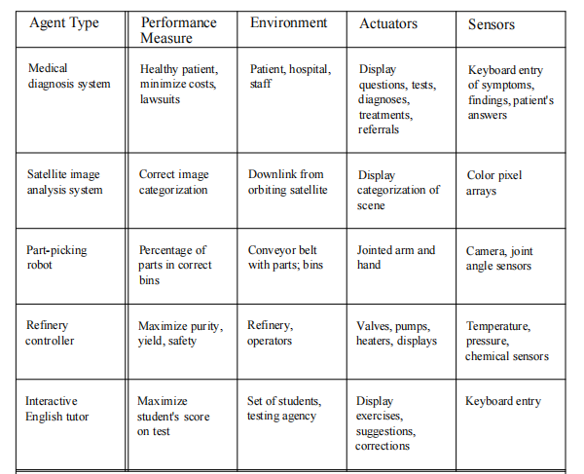
Properties of task environments

Slide 47
Properties of task environments
PEAS Descriptors for automated Taxi Driver
Performance Measure | Safety, time, legal drive, comfort
Environment | Roads, other cars, pedestrians, road signs
Actuators | Steering, accelerator, brake, signal, horn
Sensors | Camera, sonar, GPS, Speedometer, odometer, accelerometer, engine sensors, keyboard
PEAS for vacuum cleaner
Performance Measure | cleanness, efficiency: distance traveled to clean, battery life, security
Environment | room, table, wood floor, carpet, different obstacles
Actuators | wheels, different brushes, vacuum extractor
Sensors | camera, dirt detection sensor, cliff sensor, bump sensors, infrared wall sensors

Slide 48
Types of Agents
Simple reflex agent
Model based agent
Goal based agent
Utility based agent
Learning agent

Slide 49
Types of Agents
1. Simple reflex agent
Simple reflex agent is said to be the simplest kind of agent.
These agents select an action based on the current percept ignoring the rest of the percept history.
These percept to action mapping which is known as condition-action rules (so-called situation–action rules, productions, or if–then rules) in the simple reflex agent.
It can be represented as follows:
if {set of percepts} then {set of actions}

Slide 50
Types of Agents
Limitations
Sensors: Collect information about the current state of the environment.
Rules/Conditions: Define a set of rules or conditions based on the sensor input to make decisions.
Actuators: Execute actions based on the decision made by the rules.

Slide 51
Types of Agents
Example:
Let's consider a simple reflex agent for a thermostat that controls the heating system in a room. The goal is to maintain the room temperature at a comfortable level (e.g., 20 degrees Celsius). The agent will have a sensor to measure the current room temperature and an actuator to control the heating system.

Slide 52
Types of Agents
# Simple Reflex Agent Program for a Thermostat
def simple_reflex_agent(current_temperature):
# Rules/Conditions
if current_temperature < 20:
return "Turn on heating"
elif current_temperature > 20:
return "Turn off heating"
else:
return "Maintain current state"

Slide 53
Types of Agents
# Example Usage
current_room_temperature = 18 # Assume the current room temperature is 18 degrees Celsius
action = simple_reflex_agent(current_room_temperature)
# Actuators
if action == "Turn on heating":
print("Heating system turned on.")
elif action == "Turn off heating":
print("Heating system turned off.")
else:
print("Room temperature is at a comfortable level.")

Slide 54
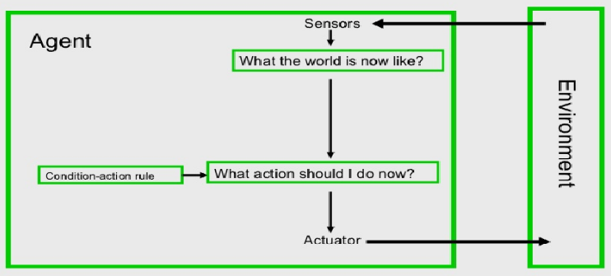
Types of Agents

Slide 55
Types of Agents
Limitations
Intelligence level in these agents is very limited.
It works only in a fully observable environment.
It does not hold any knowledge or information of nonperceptual parts of state.
Because of the static knowledge based; it’s usually too big to generate and store.
If any change in the environment happens, the collection of the rules are required to be updated.

Slide 56
Types of Agents
2. Model based agent
A model-based agent is an artificial intelligence agent that maintains an internal model or representation of the world. Unlike a simple reflex agent, a model-based agent considers not only the current percept but also incorporates past percepts and actions to build a model of how the world behaves. This internal model helps the agent make more informed decisions by anticipating the consequences of its actions.

Slide 57
Types of Agents
2. Model based agent
Model-Based Agent Program:
Percept History: Maintain a history of past percepts and actions.
Update Model: Use the percept history to update the internal model of the world.
Decision Making: Make decisions based on the updated model.
Actuators: Execute actions based on the decision made by the updated model.

Slide 58
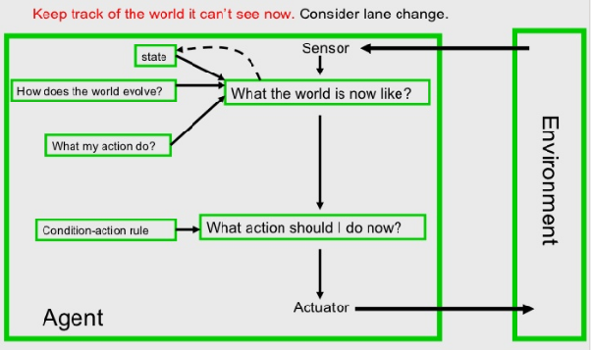
Types of Agents

Slide 59
Types of Agents
2. Model based agent
Example:
Consider a simple model-based agent for a vacuum cleaner. The goal is to clean a room, and the agent needs to decide whether to move left, move right, or clean based on its internal model of the room's state.

Slide 60
Types of Agents
2. Model based agent
class VacuumCleanerAgent:
def __init__(self):
self.internal_model = {'A': 'Dirty', 'B': 'Dirty'} # Initial model of room state
self.percept_history = []
def update_model(self, percept, action):
# Update internal model based on the percept and action
self.percept_history.append((percept, action))

Slide 61
Types of Agents
2. Model based agent
# Update the model based on the observed state
location, status = percept
self.internal_model[location] = status
def decide_action(self):
# Decision making based on the internal model
dirty_locations = [loc for loc, status in self.internal_model.items() if status == 'Dirty']

Slide 62
Types of Agents
2. Model based agent
if dirty_locations:
# If there are dirty locations, choose one to clean
return 'Clean', dirty_locations[0]
else:
# If the room is clean, move to the next available location
last_location, _ = self.percept_history[-1] if self.percept_history else ('A', 'Clean')
return 'Move', 'B' if last_location == 'A' else 'A'

Slide 63
Types of Agents
2. Model based agent
# Example
vacuum_agent = VacuumCleanerAgent()
# Initial percept
initial_percept = ('A', 'Dirty')
# Agent makes a decision and takes an action
action, location = vacuum_agent.decide_action()
print(f"Action: {action}, Location: {location}")
# Update internal model based on the percept and action
vacuum_agent.update_model(initial_percept, action)
# Display the updated internal model
print("Internal Model:", vacuum_agent.internal_model)

Slide 64
Types of Agents
3. Goal based
A goal-based agent is an artificial intelligence agent that operates by considering its goals and making decisions to achieve those goals. Unlike simple reflex agents and model-based agents, goal-based agents focus on achieving specific objectives rather than just reacting to the current state of the environment.

Slide 65
Types of Agents
3. Goal based
Goal-Based Agent Program:
Goals: Define the goals or objectives the agent wants to achieve.
Action Planning: Develop a plan or sequence of actions to reach the goals.
Decision Making: Make decisions based on the current state and the plan to move closer to the goals.
Actuators: Execute actions based on the decision made by the goal-based planning.

Slide 66
Types of Agents
3. Goal based
consider a simple goal-based agent for a delivery robot. The goal is to deliver a package from point A to point B. The agent will have to navigate through a grid-like environment to reach its destination.

Slide 67
Types of Agents
3. Goal based
# Goal-Based Agent Program for a Delivery Robot
class DeliveryRobotAgent:
def __init__(self, current_location, destination):
self.current_location = current_location
self.destination = destination
def define_goals(self):
# Define the goal of reaching the destination
return f"Reach {self.destination}"

Slide 68
Types of Agents
3. Goal based
def plan_action_sequence(self):
# Create a plan to move from the current location to the destination
# For simplicity, let's assume a grid-like environment
actions = []

Slide 69
Types of Agents
3. Goal based
while self.current_location != self.destination:
if self.current_location[0] < self.destination[0]:
actions.append('Move right')
self.current_location = (self.current_location[0] + 1, self.current_location[1])
elif self.current_location[0] > self.destination[0]:
actions.append('Move left')
self.current_location = (self.current_location[0] - 1, self.current_location[1])

Slide 70
Types of Agents
3. Goal based
if self.current_location[1] < self.destination[1]:
actions.append('Move up')
self.current_location = (self.current_location[0], self.current_location[1] + 1)
elif self.current_location[1] > self.destination[1]:
actions.append('Move down')
self.current_location = (self.current_location[0], self.current_location[1] - 1)
return actions

Slide 71
Types of Agents
3. Goal based
def execute_action(self, action):
# Execute the planned action
print(f"Executing: {action}")
# Example Usage
robot_agent = DeliveryRobotAgent(current_location=(0, 0), destination=(3, 2))
# Define the goal
goal = robot_agent.define_goals()
# Plan the action sequence
action_sequence = robot_agent.plan_action_sequence()
# Execute each action in the sequence
for action in action_sequence:
robot_agent.execute_action(action)

Slide 72
Types of Agents
3. Goal based
In this example, the ‘DeliveryRobotAgent’ defines a goal of reaching a destination. It then plans a sequence of actions to move from the current location to the destination using simple grid-based movements (move left/right/up/down). The agent executes each action in the sequence until it reaches the goal.
This showcases the basic structure of a goal-based agent, where the agent plans and executes actions to achieve a predefined goal. In more complex scenarios, the planning process might involve more sophisticated algorithms, and the goals could be dynamically adjusted based on the environment's changing conditions.

Slide 73
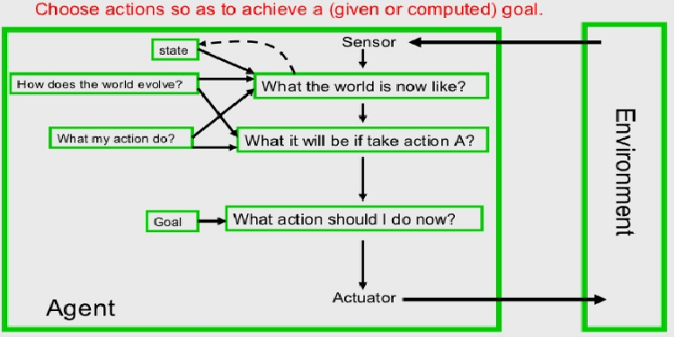
Types of Agents

Slide 74
Types of Agents
4. Utility based agent
A utility-based agent is an artificial intelligence agent that makes decisions by considering the utility or desirability of different actions. The agent evaluates the outcomes of various actions and selects the one with the highest expected utility. Utility is a measure of the desirability or satisfaction associated with achieving a particular state or outcome.

Slide 75
Types of Agents
4. Utility based agent
Utility-Based Agent Program:
Define Utility Function: Specify a utility function that assigns a numerical value to each possible state or outcome, indicating its desirability.
Evaluate Actions: For each possible action, estimate the expected utility by considering the potential outcomes and their associated utilities.
Decision Making: Select the action with the highest expected utility.
Actuators: Execute the chosen action.
Example:
Consider a simple utility-based agent for a restaurant recommendation system. The goal is to recommend a restaurant to a user based on their preferences for cuisine, price, and distance.

Slide 76
Types of Agents
4. Utility based agent
Utility-Based Agent Program:
Define Utility Function: Specify a utility function that assigns a numerical value to each possible state or outcome, indicating its desirability.
Evaluate Actions: For each possible action, estimate the expected utility by considering the potential outcomes and their associated utilities.
Decision Making: Select the action with the highest expected utility.
Actuators: Execute the chosen action.

Slide 77
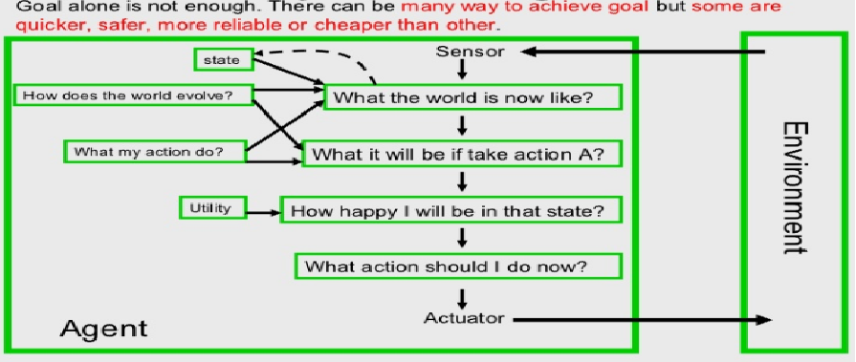
Types of Agents

Slide 78
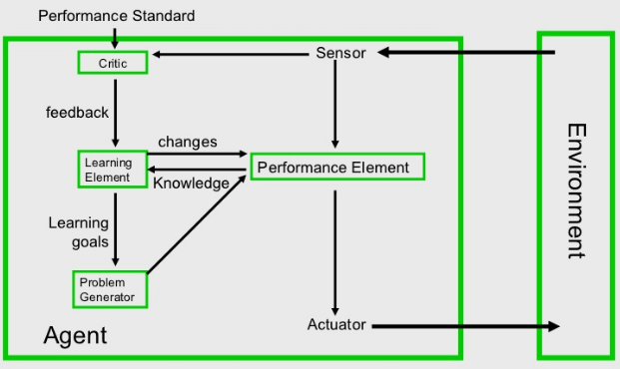
Types of Agents
5. Learning agent
By actively exploring and experimenting with their environment, the most powerful agents are able to learn.
A learning agent can be further divided into the four conceptual components

